Slide 1
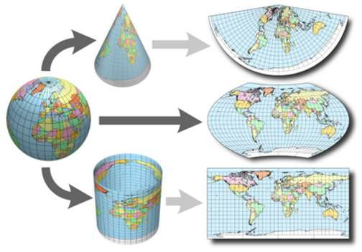
Coordinate System and Map Projection

Slide 2
Food for thought !!
What are the ways in which you would give your location to someone else?

Slide 3
Why do we need spatial referencing system?
Position of any object is described in reference to other objects/system.
Without any reference, it is impossible to describe the position of an object.
GIS works on georeferenced data and hence it is important to understand spatial referencing

Slide 4
Coordinate Syste
For spatial referencing, we need a coordinate system that uniquely identifies location. There are two types of coordinate system.
Geographic Coordinate System
Projected Coordinate System

Slide 5
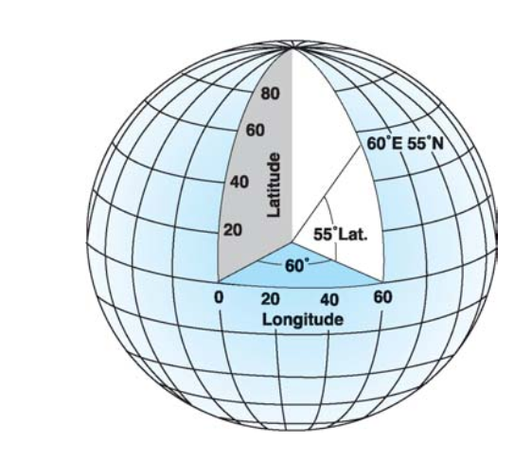
Geographic Coordinate System
A geographic coordinate system (GCS) uses a three-dimensional spherical surface to define locations on the earth.
A point is referenced by its longitude and latitude values. Longitude and latitude are angles measured from the earth's center to a point on the earth's surface.
Notes:
Geographic coordinate systems (lat/long) are based on a spheroidal (either truly spherical or ellipsoidal) surface that approximates the surface of the earth. A datum typically defines the surface (ex radius for a sphere, major axis and minor axis or inverse flattening for an ellipsoid) and the position of the surface relative to the center of the earth. An example of a datum is NAD 1927,

Slide 6
Geographic Co-ordinate System
Angular measurement using spherical geometry.
Equator has 0 degree latitude.
Latitude: the angle between the equatorial plane and the straight line that passes through that point and through the center of the Earth.
Prime Meridian has 0 degree longitude and passes through Greenwich, England.
Longitude: is the angle east or west from a reference meridian to another meridian that passes through that point
Degree, minute, second tell how far a particular location from Prime Meridian and Equator.

Slide 7
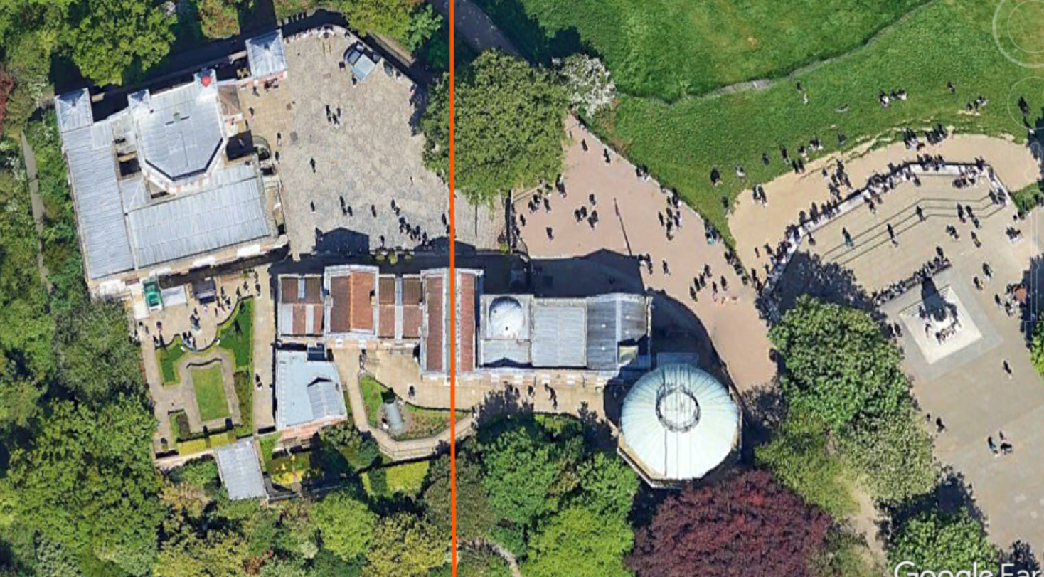
Prime Meridian Line at Greenwich, England

Slide 8
Geographic Co-ordinate System
Universal Co-ordinate System: Lat/Long
Lat/Long is good for locating positions on surface of a globe.
But Lat/Long is not efficient for measuring distances and areas!
Longitude and latitude are not uniform units of measure.
One degree longitude at equator = 111.321 km
(Clarke 1866 equator)
One degree longitude at 60 degree latitude = 55.802 km
(Clarke 1866 equator)
GIS softwares are still not efficient in analysis based on Geographic Co-ordinate System.

Slide 9
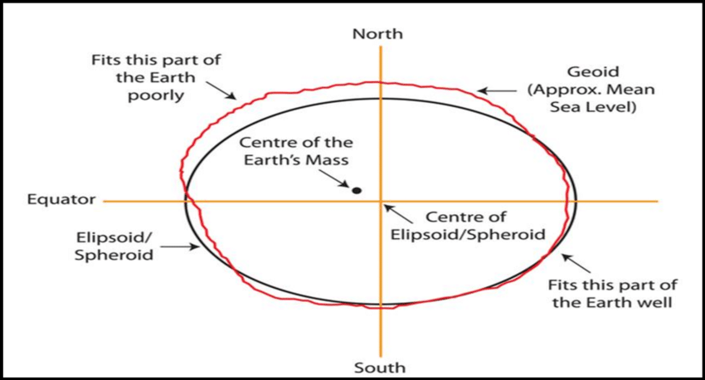
Horizontal Datum
The shape and size of a geographic coordinate
system’s surface is defined by a sphere or spheroid/ellipsoid.
An ellipsoid best fitting the whole earth or the specific area to be mapped is taken as the reference ellipsoid.

Slide 10
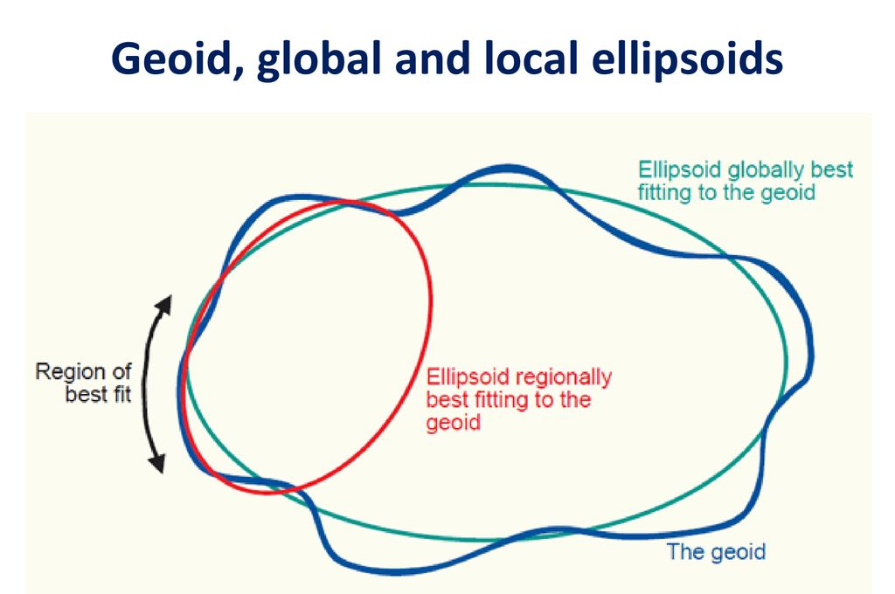
Local and Global Ellipsoids
Local ellipsoids best fit a region only (a country or a group of country).
Eg: Everest 1830 (Used by Nepal, India and neighboring countries)
Global ellipsoids are best fit to a globally.
Eg: WGS1984 (Used in GPS system)

Slide 11
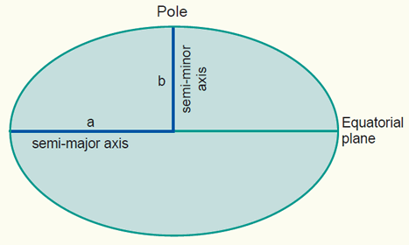
How is a ellipsoid defined mathematically?
An ellipsoid is defined by:
Semi-major axis (a)
Flattening (f) = (a-b)/a

Slide 12
How is a ellipsoid defined mathematically?
For Everest 1830
Semi-major axis (a) = 6377276.345,
Flattening factor (f) = (a-b)/a = 1/300.8017

Slide 13
How is a ellipsoid defined mathematically?
For WGS1984 (used by GPS)
Semi-major axis (a) = 6378137.000
Flattening factor (f) = (a-b)/a = 1/298.257223563

Slide 14
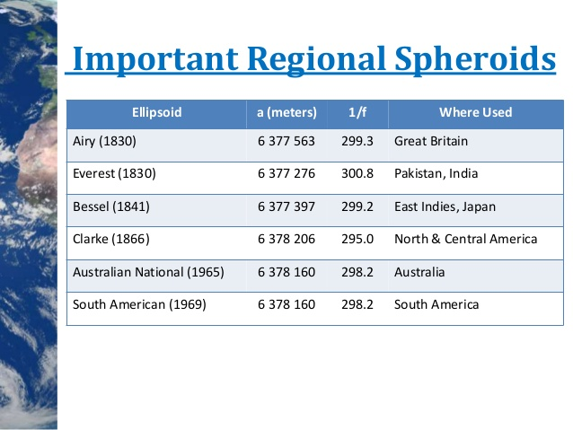

Slide 15
Map Projection and Projected Coordinate System

Slide 16
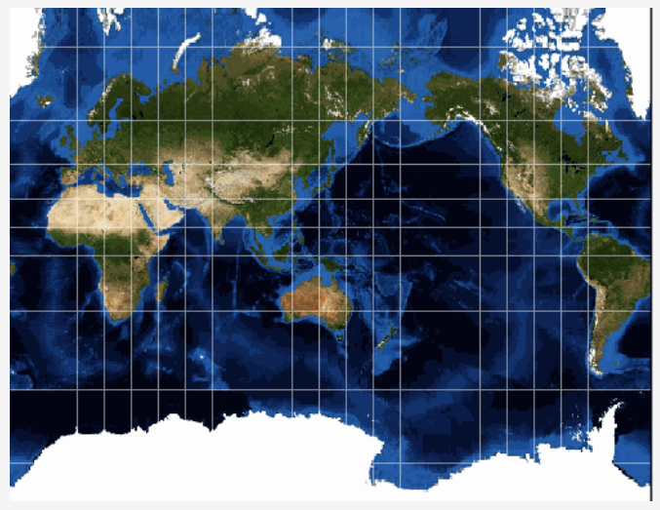
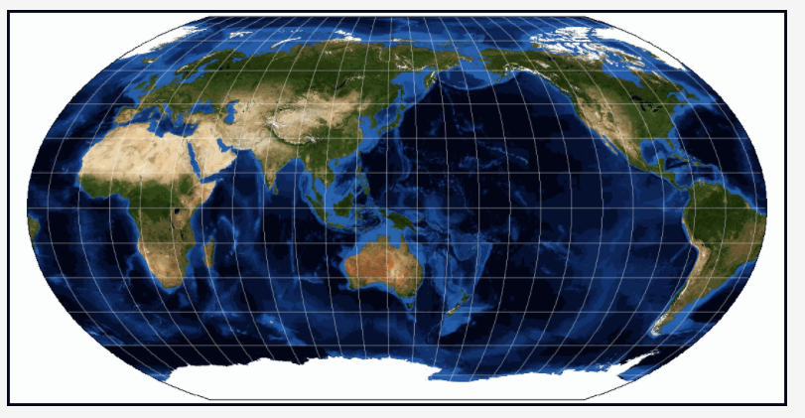
Food for thought : World Maps

Slide 17
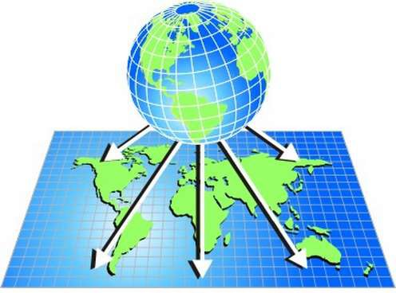
Map Projection
A method by which the curved surface of the earth is represented on a flat surface.
Earth surface in reality is a curved surface with no perfect geometrical shape.
Mapping in a globe is an easy way to map the earth.
Representation of Earth (ellipsoidal surface) into a map (flat) surfaces is not a straight forward process.
Representation of Earth as a map causes distortion in the shape, area, distance or direction of the data.
Notes:
Map Projection: It is a method for representing a spherical or curved surface on a flat plane.
Datum: It is the reference or origin based on which measurements are made.

Slide 18
Map Projection parameters
Origin : One particular common point of plane of the map and the ellipsoid surface. The point which has co-ordinates (0,0).
Central meridian : The meridian of the projection zone origin. Provides the direction of the northing axis of the projected co-ordinate system.
Standard parallel : The line of latitude where the projection surface touches the globe.
Scale factor : Ratio of distance on the projection at central meridian to distance on the sphere
False easting, false northing : To avoid negative co-ordinates over parts of a map, the origin is usually given false co-ordinates which are large enough to avoid the inconvenience.

Slide 19
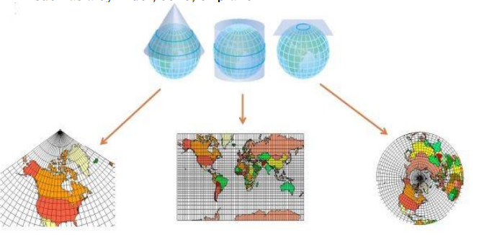
Classification of map projection
Accoding to developing surface (class)
Cylinderical
Concial
Azimuthal
azimuthal — the imaginary ‘piece of paper’ is flat, this is usually used over Polar areas
conical — the imaginary ‘piece of paper’ is rolled into a cone, this is usually used in mid-latitude areas (approximately 20° – 60° North and South)
cylindrical — the imaginary ‘piece of paper’ is rolled into a cylinder, this is usually used over Equatorial areas or for World Maps

Slide 20
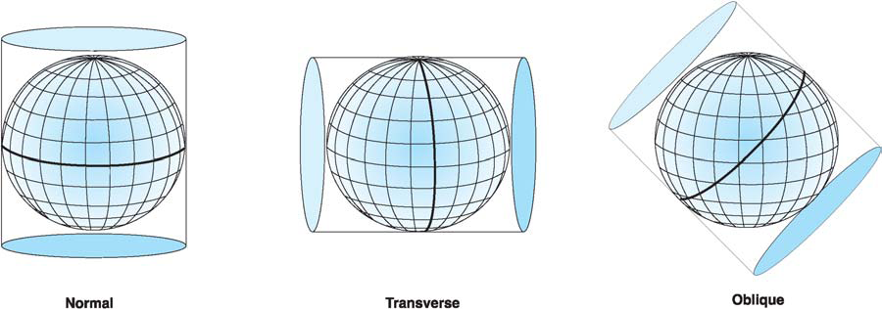
Classification of map projection
2. Accoding to aspect (orientation)
Normal
Oblique
Transverse

Slide 21
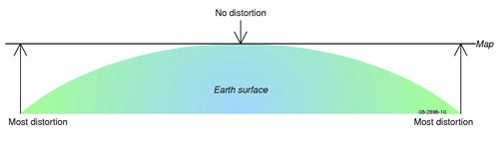
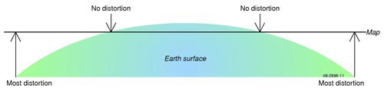
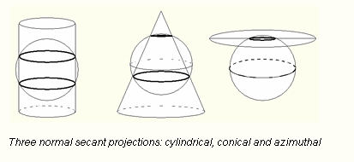
Tangent or secant projection plane
Tangent Projection Plane
Secant Projection Plane
Tangent- projection surface just touches the globe.
secant - projection surface intersects the globe.

Slide 22
Classification of map projection
3. According to property
Equivalent (equal - area)
(area is preserved)
b. Equidistant
(distance from a single locaiton to all other locations are preserved.)
c. Conformal
(local shapes are preserved)
d. Compromise
(neither conformal nor equal area, but a balance)

Slide 23
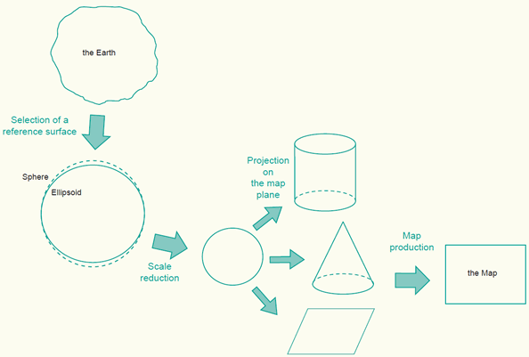
Overall Process of Map Projection
Notes:
Includes two operations:
Alteration of Scale.
Transformation to Plane surface.

Slide 24
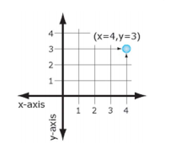
Projected Coordinate System
A planar coordinate system, which enables point location on a two-dimensional plane representing the surface of the Earth
Measurements of x and y distances provided in the unit of the particular coordinate system (e.g. feet, meters)
Notes:
Projection (Projected Coordinate System) is a series of transformations which convert the location of points on a curved surface(the reference surface or datum) to locations on flat plane (ie transforms coordinates from one coordinate reference system to another).

Slide 25
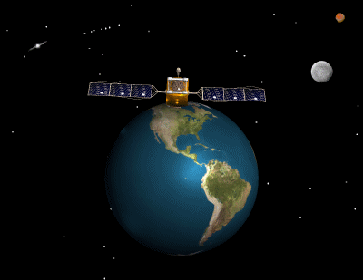
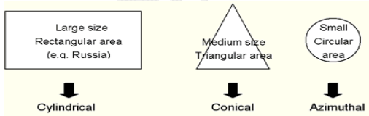
Choosing a Map Projection
The ideal map projection for any country would be an azimuthal, cylindrical or conical projection, depending on the country’s shape, with a secant projection plane located along the country’s main axis. The property of the map projection depends upon the map purpose.

Slide 26
Choosing a Map Projection
Purpose of the map
Conformal : maps which require measuring angles, topographic maps.
Equivalent : maps which require measuring areas (distribution maps)
Equidistant: maps which require reasonable area and angle distortions (several thematic maps)

Slide 27
Coordinate System Used in Nepal for Topographic Mapping
Nepal adopt projected coordinate system, so called Modified UTM (Universal Transverse Mercator) projection
Nepal has larger east west extension, so to obtain finer results for base map, 3⁰ zones are used for mapping
to reduce the amount of distortion, scale factor of 0.9999 has been chosen
3 zones cover Nepal with central meridians 81⁰, 84⁰ and 87⁰

Slide 28
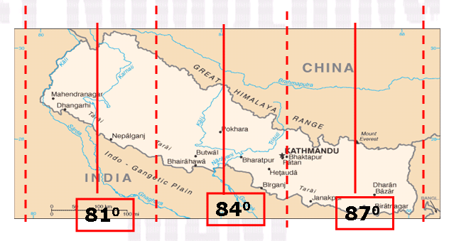
False Easting: 5,00,000m for each central meridian
False Northing: 0m
Central Meridian: 81, 84, 87
Scale Factor: 0.9999
Latitute of origin: 0

Slide 29
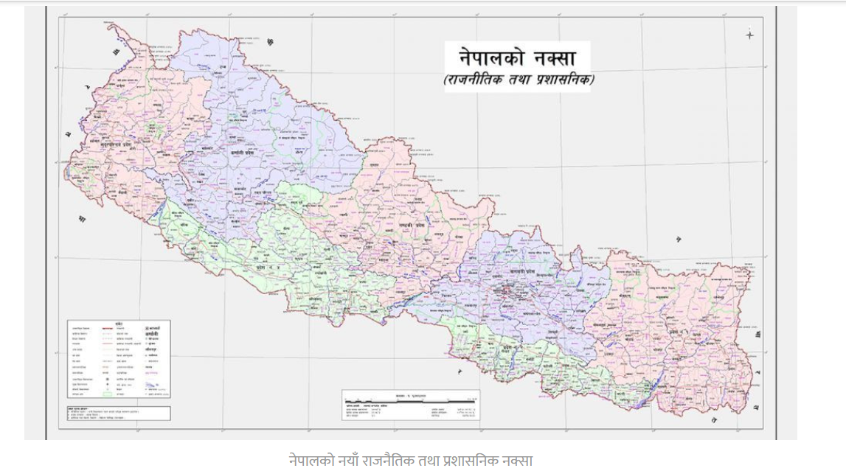
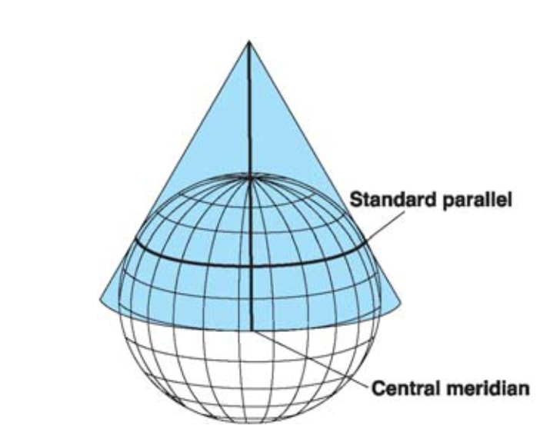
Coordinate System Used in Nepal for New Map of Nepal
Nepal uses Lambert Conformal Conic (LCC) for the new map

Slide 30
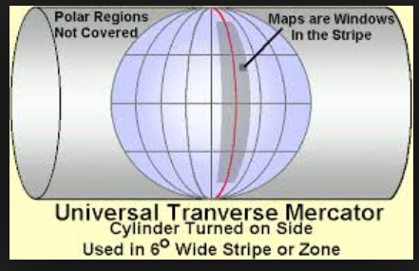
Universal Transverse Mercator (UTM) Projection System
Developed by US Army Map Servide
Based on transverse cylinderical projection.
The area of the earth between 84º N and 80º S latitude is divided into north-south columns 6º of longitude wide called zones. There are numbered 1 to 60 east ward, beginning at the 180 º meridian.
Each column is divided into quadrilaterals 8 º of latitude high.
The rows of quadrilaterals are assigned letters c to x consecutively (with I and O omitted) beginning at 80 º S latitude. Row x is beginning 12 º latitude extending from 72 º N to 84 º N. Each quadrilateral is assigned a number letter combination.

Slide 31
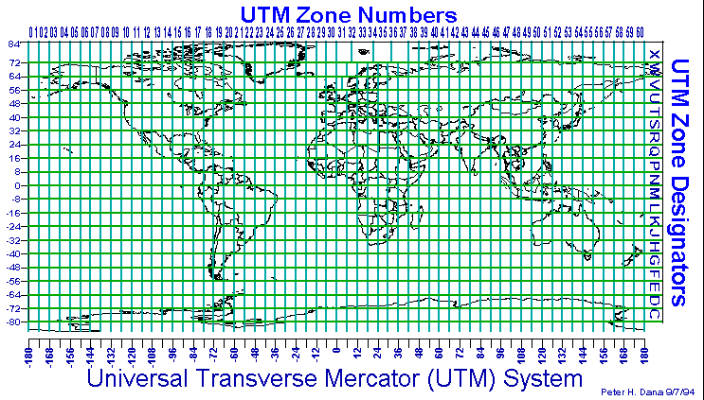
UTM Projection System

Slide 32
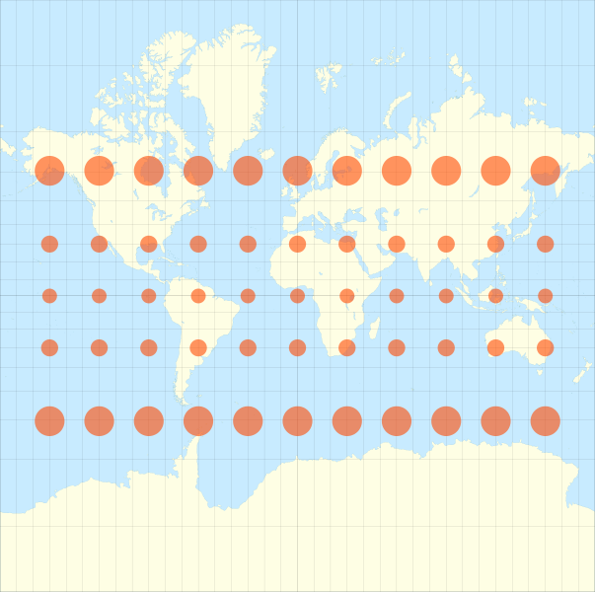
Tissot's Indicatrix
Scale distortions can be measured and shown on a map by ellipses of distortion called Tissot's Indicatrix, which shows the shape of an infinitesimally small circle with a fixed scale on the earth as it appears when plotted on the map.
The size and shape of the ellipse shows how much the scale is changed and in what direction.

Slide 33
Common Projections
Projection | Type | Key virtues | Comments
Stereographic | azimuthal | conformal | Created before 150 AD Best Used in areas over the Poles or for small scale continental mapping
Lambert Conformal Conic | conic | conformal | Created in 1772 Best Used in mid-latitudes – e.g. USA, Europe and Australia
Mercator | cylindrical | conformal and true direction | Created in 1569 Best Used in areas around the Equator and for marine navigation
Robinson | pseudo-cylindrical | all attributes are distorted to create a ‘more pleasant’ appearance | Created in the 1963 Best Used in areas around the Equator
Transverse Mercator | cylindrical | conformal | Created in 1772 Best Used for areas with a north-south orientation

Slide 34

Does it make sense now?
PROJCS["NEPAL_MUTM_CM_87_EVEREST_1830",GEOGCS["GCS_Everest_1830",DATUM["D_Everest_1830",SPHEROID["Everest_1830",6377276.345,300.8017]],PRIMEM["Greenwich",0.0],UNIT["Degree",0.0174532925199433]],PROJECTION["Transverse_Mercator"],PARAMETER["False_Easting",500000.0],PARAMETER["False_Northing",0.0],PARAMETER["Central_Meridian",87.0],PARAMETER["Scale_Factor",0.9999],PARAMETER["Latitude_Of_Origin",0.0],UNIT["Meter",1.0]]

Slide 35
From ArcGIS list 5 Geographic and 5 Projected Coordinate System. Also list their parameters.
Spheroid
Semi major Axis
Semi minor Axis
Flattening
Projection
False_Easting
False Northing
Central Meridian
Scale Factor
Latitude of Origin

Slide 36
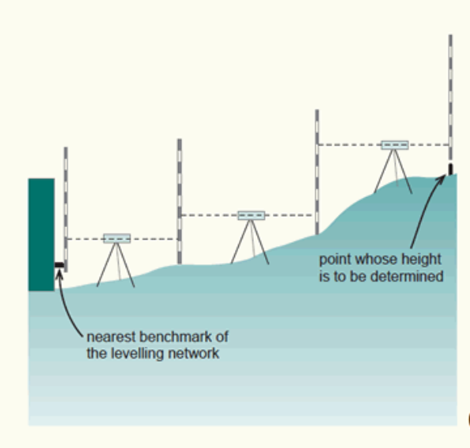
Vertical Datum
An imaginary surface of zero height is needed to describe the heights.
Geoid or mean sea level
The Mean Sea Level (MSL) of Indian Ocean at Bay of Bengal is taken as the datum plane for measuring height i.e. vertical datum for Nepal.

Slide 37
Reading and Reference Materials
Choosing the right projection
https://source.opennews.org/articles/choosing-right-map-projection/
Map Projection tool
https://projectionwizard.org
…..

Slide 38
End of Session
Coordinate System and Map Projection

